Slide 1
Fake news detection with R
Vinay Bhandaru

Slide 2
Kaggle fake news dataset
https://www.kaggle.com/datasets/emineyetm/fake-news-detection-datasets
21,417 Real-News articles collected from Reuters.com
23,481 Fake News articles collected from unreliable websites flagged by Politifact
The majority of articles are about politics and world news
Examples of fake news websites flagged by Politifact
16WMPO.com
24online.news
24wpn.com
24x365live.com
247NewsMedia.com
a-news24.com
https://www.politifact.com/article/2017/apr/20/politifacts-guide-fake-news-websites-and-what-they/

Slide 3
Fake new detection
The objective of this project is to build a logistic regression model to detect fake news articles based on the Kaggle dataset
The unnest_tokens() function from tidytext R package was used to tokenize the text into individual words and then word frequencies and proportions were calculated and used to predict whether an article is real or fake:
Number and proportion of stop words, which are frequently used words like "a," "the," "is," and "and"
Number and proportion of negative words like “bad”
Number and proportion of positive words like “good”
Number and proportion of words only common in fake news articles
Number and proportion of words only common in real news articles

Slide 4
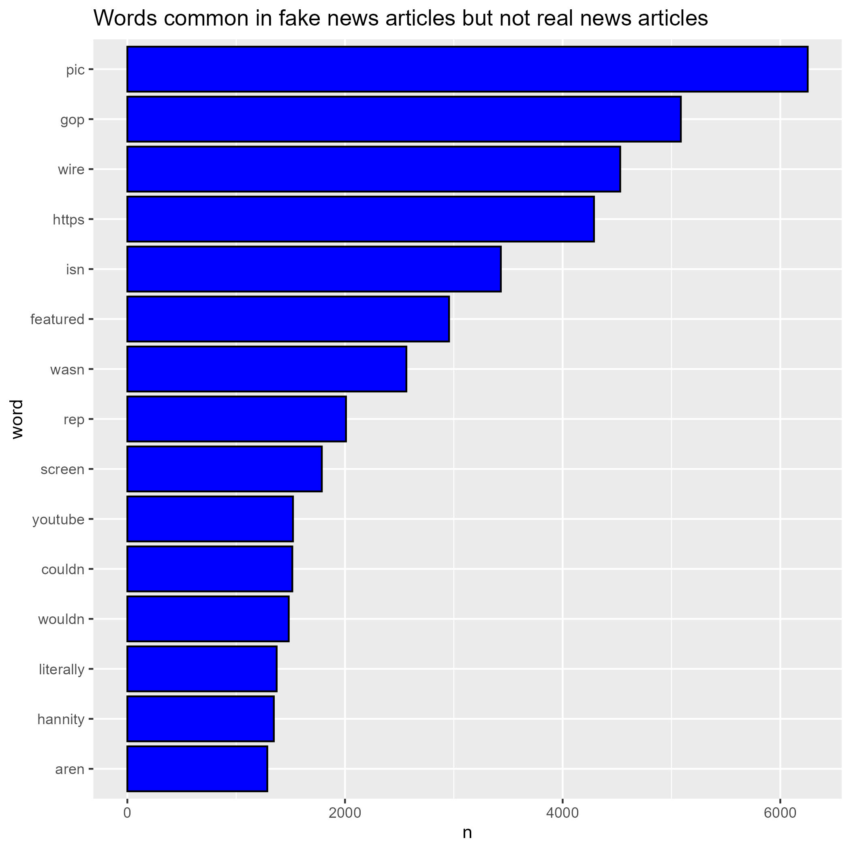
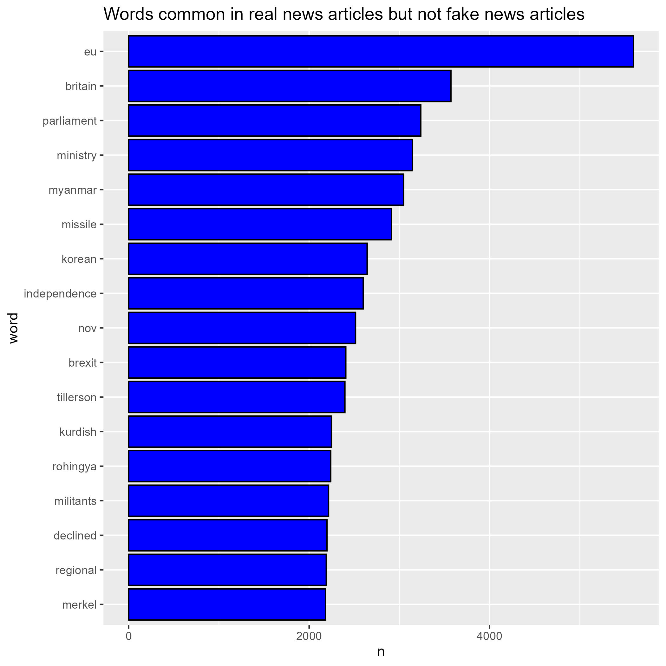
Words specific to real or fake articles
"reuters" was the most common word distinguishing real articles but it was excluded because all real articles are from reuter's website

Slide 5
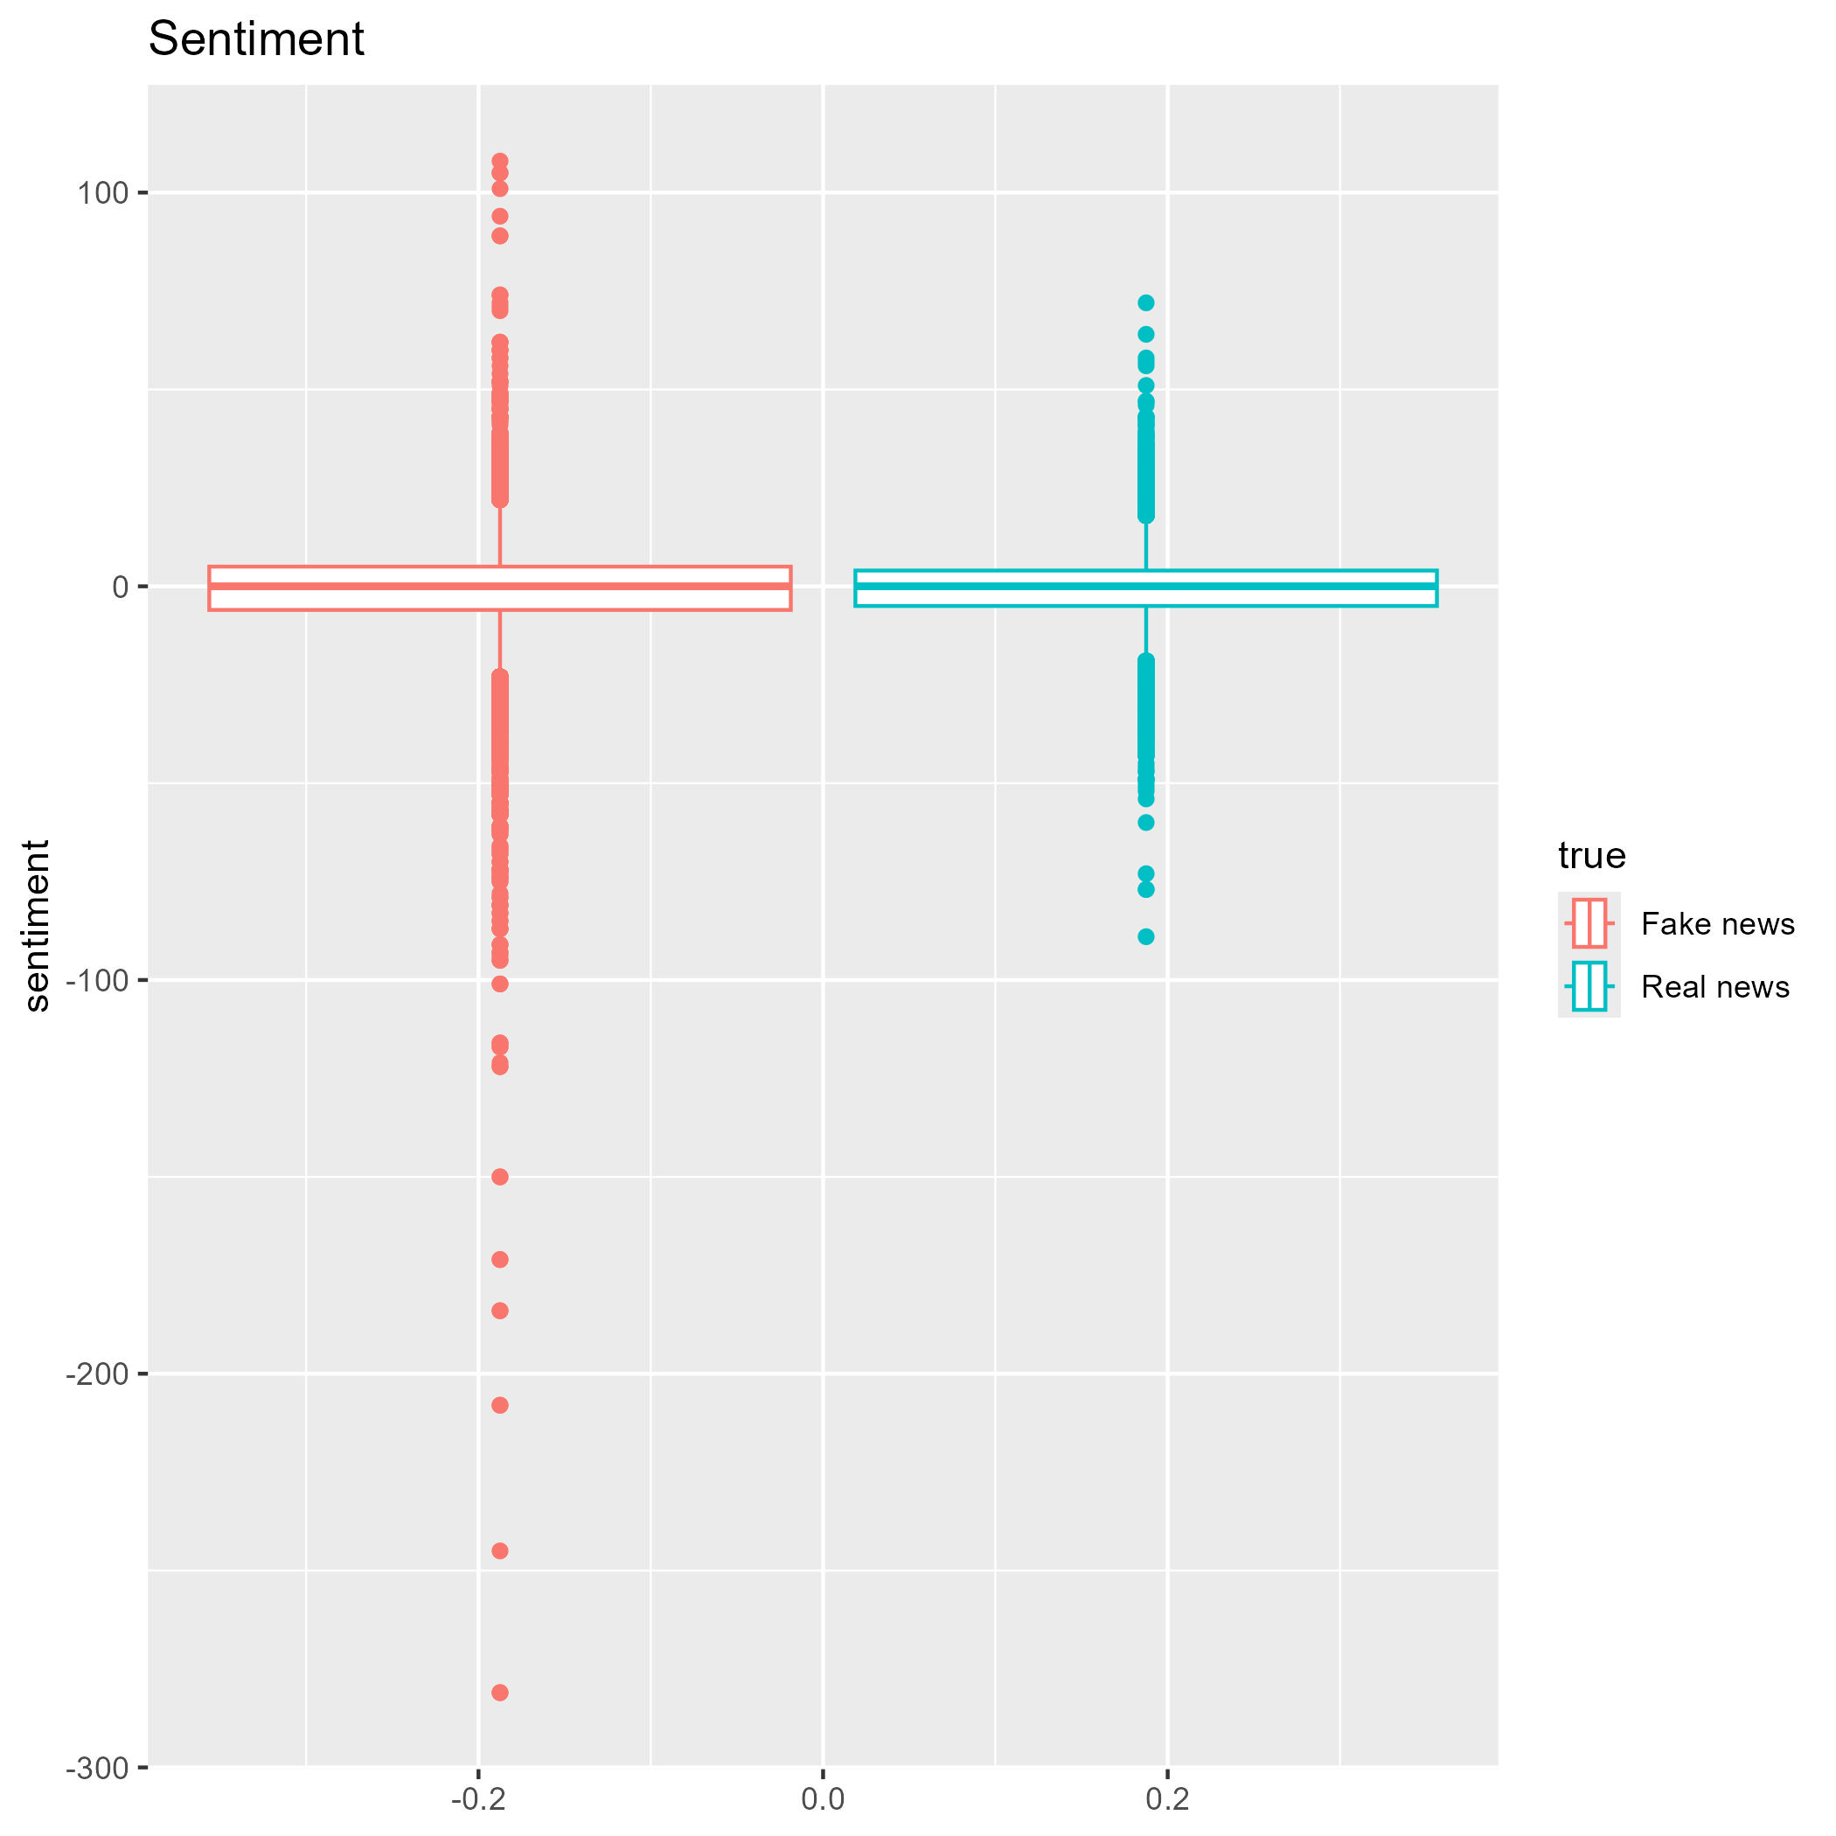
Positive and negative words
Sentiment is the difference between the number of positive words and negative words in an article
Both types of articles had a negative mean sentiment score, but fake news articles were more negative on average
 | Mean | Standard Dev. | Median | Minimum | Maximum
Fake news | -1.24 | 12.55 | 0 | -281 | 108
Real news | -0.57 | 9.41 | 0 | -89 | 72

Slide 6
Fake news detection: Results
Split data into 70% training set and 30% test set
The logistic regression model predicted correctly in the test set with an accuracy of 85% and an AUC if 0.92.
The variables from most predictive to least with individual test AUCs
Number and proportion of words only common in fake news articles (AUC: 0.81)
Number and proportion of words only common in real news articles (AUC: 0.71)
Number and proportion of stop words, which are frequently used words like "a," "the," "is," and "and" (AUC: 0.70)
Number and proportion of negative words like “bad” (AUC: 0.64)
Number and proportion of positive words like “good” (AUC: 0.63)

Slide 7
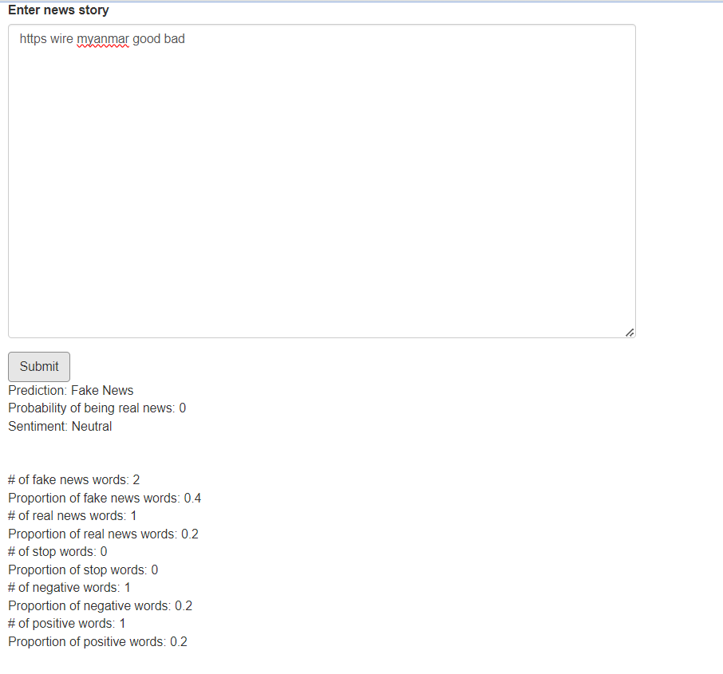
Shiny App
I created an R Shiny App with this model and you can paste text into the box and it will report the sentiment and predicted probability of being fake news

